Slide 1
Declaration of Independence
The Perfect Argument

Slide 2
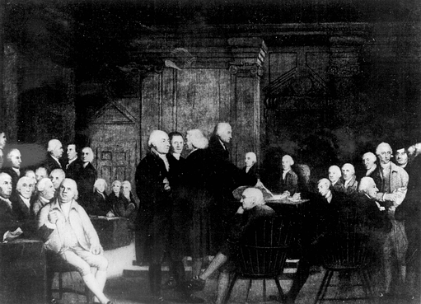
Background
Following Common Sense, more people believe that the war should be for FULL INDEPENDENCE from England
Not merely trying to fix the relationship
Congress decides that before the split, they have to explain what they are doing and why.

Slide 3
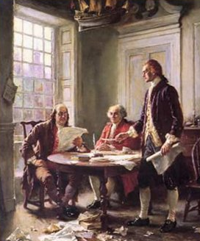
Writing Committee
Congress appoints a committee of 5 people to draft the document
John Adams
Benjamin Franklin
Thomas Jefferson
Young
Lawyer from VA
Gifted writer
Does 99% of the work of what is a PERFECT argument

Slide 4
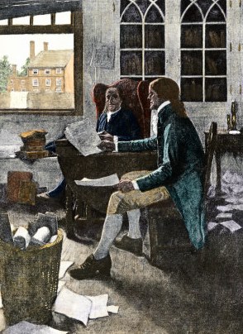
The Perfect Document
Jefferson laid out the Declaration of Independence to be
Explanation of beliefs
List of wrongs done to the colonials
What they’re going to do about it

Slide 5
Declaration of Independence
We hold these truths to be self evident, that all men are created equal, that they are endowed by their Creator with certain unalienable Rights, that among these are Life, Liberty, and the pursuit of Happiness. That to secure these rights, Governments are instituted among Men, deriving their just powers from the consent of the governed. That whenever any Form of Government becomes destructive of these ends, it is the Right of the People to alter or abolish it, and to institute new Government…
Thesis statement for new country
Everybody has NATURAL RIGHTS and government’s job is to protect those rights
When the government doesn’t do that job, people (who created it) have the right to remove that abusive government

Slide 6
Declaration of Independence
He has kept amongst us, in times of peace, Standing Armies without the Consent of our legislatures
For cutting off our Trade with all parts of the world
For imposing Taxes on us without our Consent
For depriving us in many cases, of the benefit of trial by jury
For suspending our own legislatures, and declaring themselves invested with power to legislate for us in all cases whatsoever
He has plundered our seas, ravaged our Coasts, burnt our towns, and destroyed the lives of our people
He is at this time transporting large Armies of foreign Mercenaries to complete the works of death, desolation, and tyranny, already begun…
Lists 27 of the wrongs done to the colonies by the King and Parliament

Slide 7
Declaration of Independence
In every stage of these Oppressions We have Petitioned for Redress in the most humble terms: Our repeated Petitions have been answered only by repeated injury. A Prince, whose character is thus marked by every act which may define a Tyrant, is unfit to be the ruler of a free people
We’ve tried to solve these problems peacefully but the King does not listen
He doesn’t deserve to be our ruler

Slide 8
Declaration of Independence
We, therefore, the Representatives of the United States of America…solemnly publish and declare, That these United Colonies are, and of Right ought to be Free and Independent States….
Because of all of those reasons, we are FREE!

Slide 9
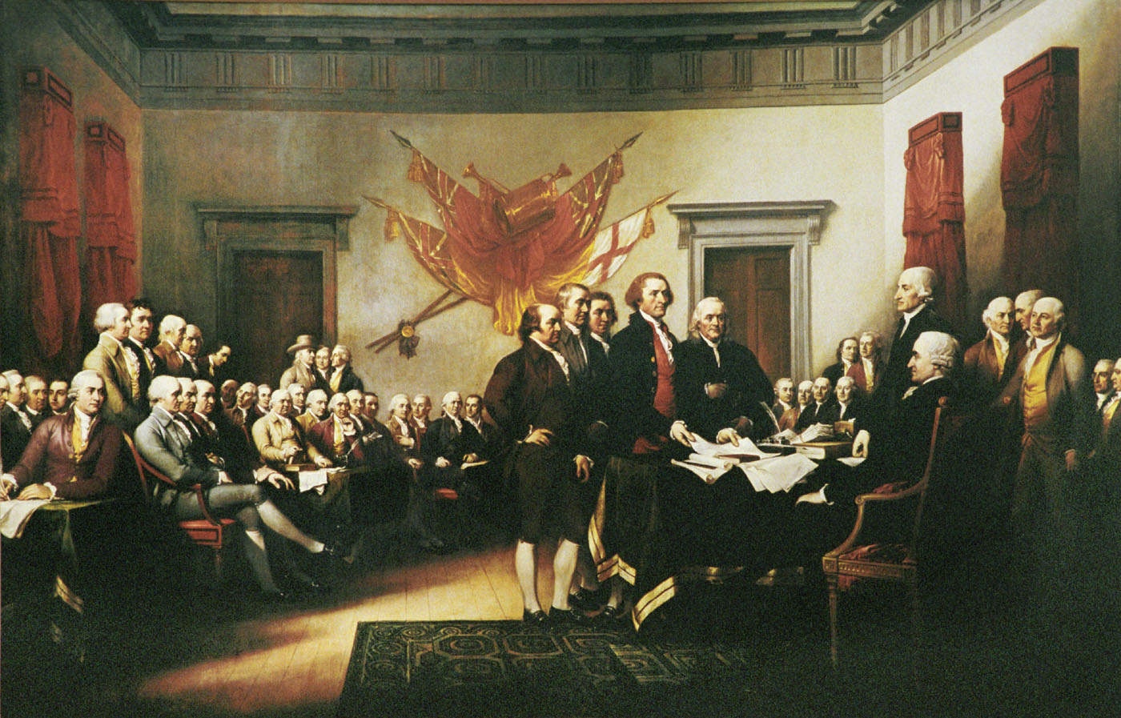
Independence Day
On July 2, 1776, the Continental Congress voted to approve Jefferson’s declaration.
Make the document public two days later
This is why we celebrate our birthday on the 4th of July
We will now be fighting for the independence the Declaration claims we have

